Slide 1
Improving Named Entity Recognition by
External Context Retrieving and Cooperative
Learning
2021,ACL
Xinyu Wang,Yong Jiang,Nguyen Bach,Tao Wang,
Zhongqiang Huang,Fei Huang,Kewei Tu
Reporter: Qiang Wang,Chenghang Hu
计算机科学与工程学院

Slide 2
目录
Content
1
Introduction
2
Method
3
Experiment
4
Conclusion

Slide 3
1
Introduction

Slide 4
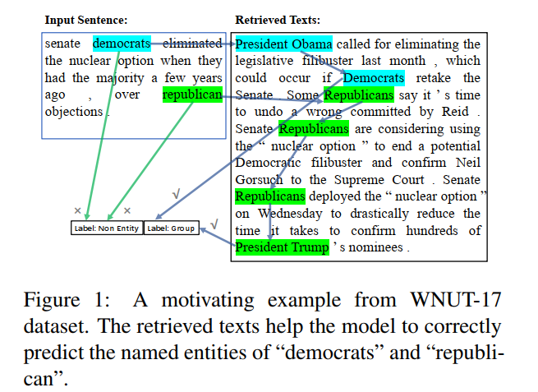
1
Introduction
A motivating example

Slide 5
1
Introduction
The contribution of this paper are:
• We propose a simple and straight-forward way to improve the contextual representation of an input sentence through retrieving related texts using a search engine.We take the retrieved texts together with the input sentence as a new retrieval-based view.
• We propose Cooperative Learning to jointly improve the accuracy of both input views in a unified model.We propose two approaches in CL based on the $L_{2}$norm and KL divergence respectively.CL can utilize unlabeled data for further improvement.

Slide 6
2
Method

Slide 7
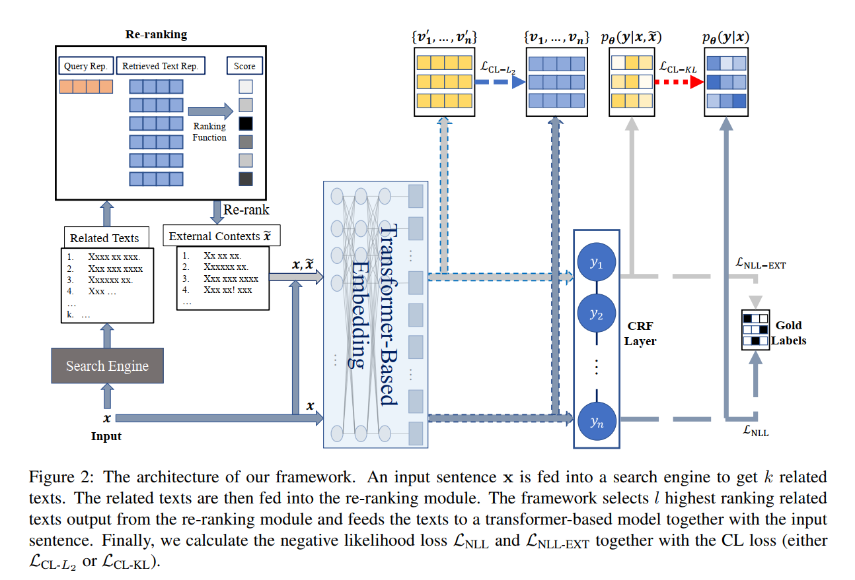
2
Method
Framework

Slide 8
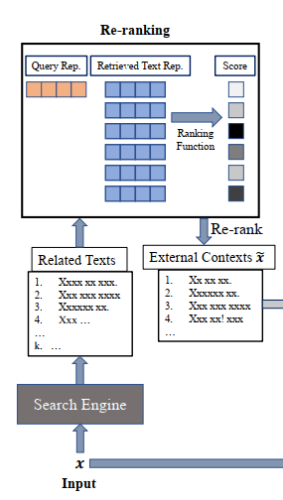
2
Method
Framework
input sentence x :
a certain retrieved text $\hat{x}$:
F1 scores:
concatenate l top-ranking texts:

Slide 9
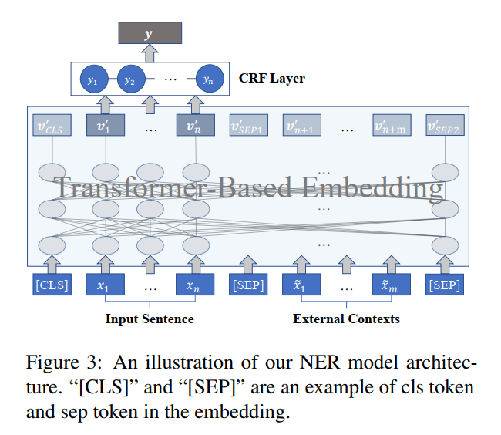
2
Method
NER Model

Slide 10
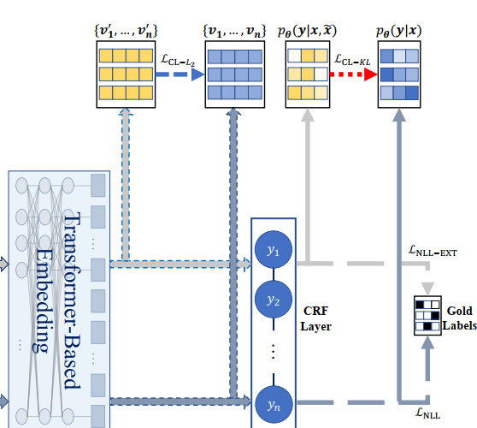
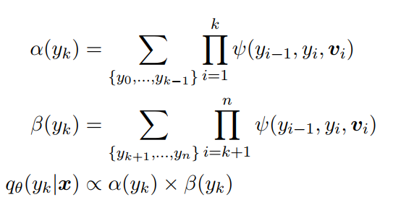
2
Method
Cooperative Learning:

Slide 11
3
Experiment

Slide 12
3
Experiment
The statistics of the datasets

Slide 13
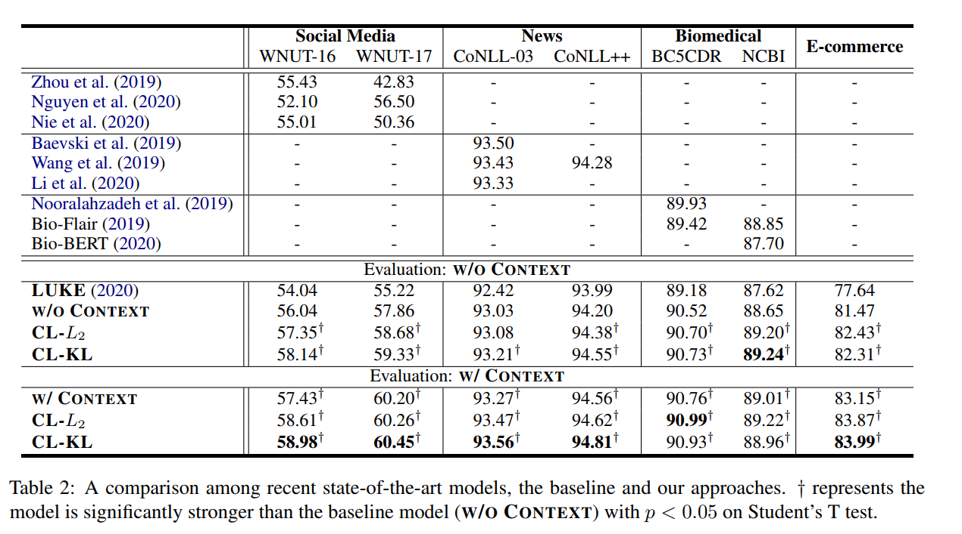
3
Experiment
Results

Slide 14
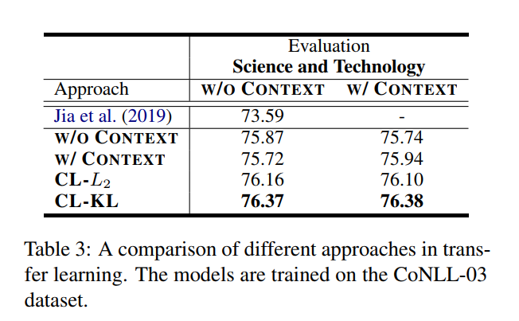
3
Experiments
Cross-Domain Transfer

Slide 15
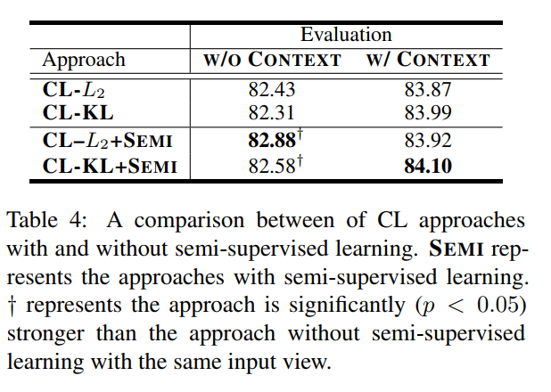
3
Experiments
Semi-supervised Cooperative Learning

Slide 16
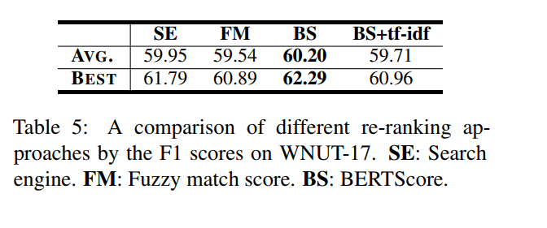
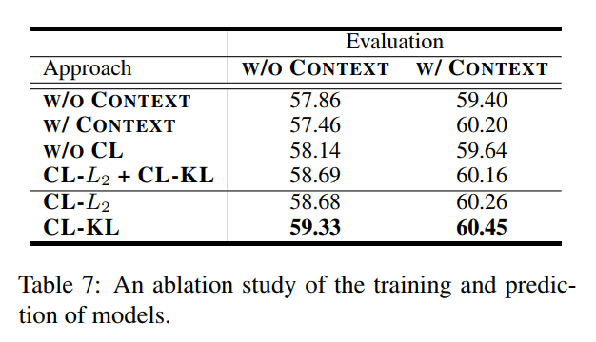
3
Experiments
Analysis
Ablation Study

Slide 17
4
Conclusion

Slide 18
4
Conclusion
In this paper,we propose to improve the NER model’s accuracy by retrieving related contexts from a search engine as external contexts of the inputs.To improve the robustness of the models when no external contexts are available,we propose Cooperative learning.Empirical results show that our approach significantly outperforms the baseline models and previous state-of-the-art approaches on the datasets over 5 domains.

